Slide 1
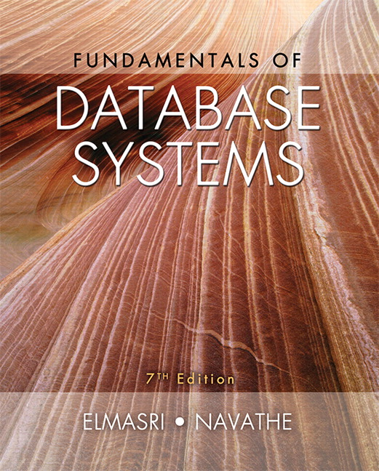

Slide 2
CHAPTER 20
Introduction to Transaction Processing Concepts and Theory

Slide 3
Introduction
Transaction
Describes local unit of database processing
Transaction processing systems
Systems with large databases and hundreds of concurrent users
Require high availability and fast response time

Slide 4
20.1 Introduction to Transaction Processing
Single-user DBMS
At most one user at a time can use the system
Example: home computer
Multiuser DBMS
Many users can access the system (database) concurrently
Example: airline reservations system

Slide 5
Introduction to Transaction Processing (cont’d.)
Multiprogramming
Allows operating system to execute multiple processes concurrently
Executes commands from one process, then suspends that process and executes commands from another process, etc.

Slide 6
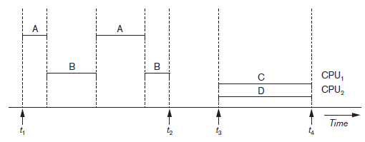
Introduction to Transaction Processing (cont’d.)
Interleaved processing
Parallel processing
Processes C and D in figure below
Figure 20.1 Interleaved processing versus parallel processing of concurrent transactions

Slide 7
Transactions
Transaction: an executing program
Forms logical unit of database processing
Begin and end transaction statements
Specify transaction boundaries
Read-only transaction
Read-write transaction

Slide 8
Database Items
Database represented as collection of named data items
Size of a data item called its granularity
Data item
Record
Disk block
Attribute value of a record
Transaction processing concepts independent of item granularity

Slide 9
Read and Write Operations
read_item(X)
Reads a database item named X into a program variable named X
Process includes finding the address of the disk block, and copying to and from a memory buffer
write_item(X)
Writes the value of program variable X into the database item named X
Process includes finding the address of the disk block, copying to and from a memory buffer, and storing the updated disk block back to disk

Slide 10
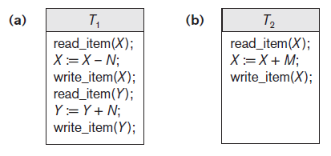
Read and Write Operations (cont’d.)
Read set of a transaction
Set of all items read
Write set of a transaction
Set of all items written
Figure 20.2 Two sample transactions (a) Transaction T1 (b) Transaction T2

Slide 11
DBMS Buffers
DBMS will maintain several main memory data buffers in the database cache
When buffers are occupied, a buffer replacement policy is used to choose which buffer will be replaced
Example policy: least recently used

Slide 12
Concurrency Control
Transactions submitted by various users may execute concurrently
Access and update the same database items
Some form of concurrency control is needed
The lost update problem
Occurs when two transactions that access the same database items have operations interleaved
Results in incorrect value of some database items

Slide 13
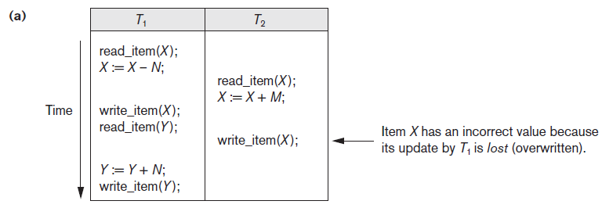
1 - The Lost Update Problem
Figure 20.3 Some problems that occur when concurrent execution is uncontrolled (a) The lost update problem
Notes:
https://www.geeksforgeeks.org/concurrency-problems-in-dbms-transactions/
The Lost Update Problem
This occurs when two transactions that access the same database items have their operations interleaved in a way that makes the value of some database item incorrect.
The Temporary Update (or Dirty Read) Problem
This occurs when one transaction updates a database item and then the transaction fails for some reason.
The updated item is accessed by another transaction before it is changed back to its original value.
The Incorrect Summary Problem
If one transaction is calculating an aggregate summary function on a number of records while other transactions are updating some of these records, the aggregate function may calculate some values before they are updated and others after they are updated.

Slide 14
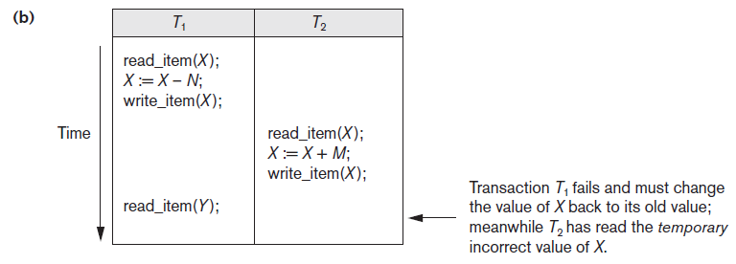
2 - The Temporary Update Problem
Figure 20.3 (cont’d.) Some problems that occur when concurrent execution is uncontrolled (b) The temporary update problem

Slide 15
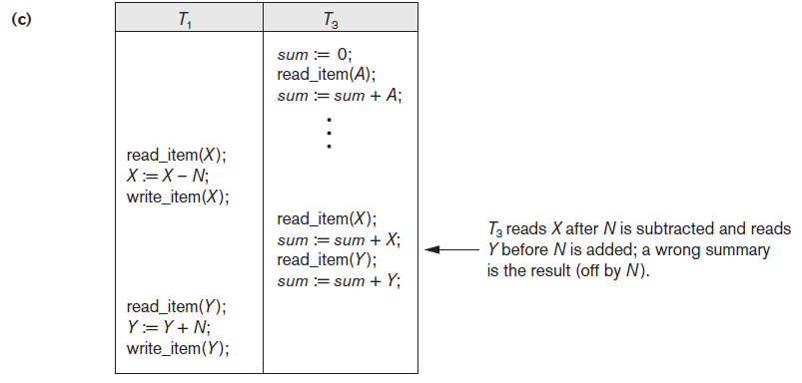
3 - The Incorrect Summary Problem
Figure 20.3 (cont’d.) Some problems that occur when concurrent execution is uncontrolled (c) The incorrect summary problem

Slide 16
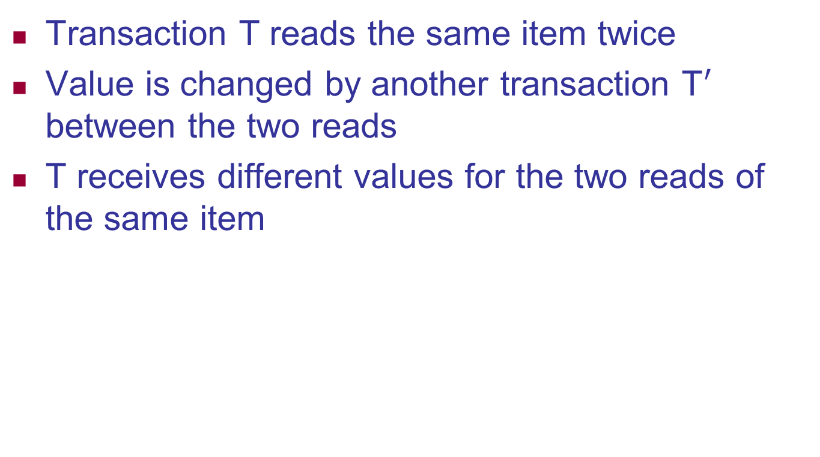
4 - The Unrepeatable Read Problem
Transaction T reads the same item twice
Value is changed by another transaction T$′$ between the two reads
T receives different values for the two reads of the same item

Slide 17
Why Recovery is Needed
Types of Transaction:
Committed transaction
Effect recorded permanently in the database
Aborted transaction
Does not affect the database

Slide 18
Why Recovery is Needed (cont’d.)
Types of transaction failures
Computer failure (system crash)
Transaction or system error
Local errors or exception conditions detected by the transaction
Concurrency control enforcement
Disk failure
Physical problems or catastrophes
System must keep sufficient information to recover quickly from the failure
Disk failure or other catastrophes have long recovery times

Slide 19
20.2 Transaction and System Concepts
System must keep track of when each transaction starts, terminates, commits, and/or aborts
BEGIN_TRANSACTION
READ or WRITE
END_TRANSACTION
COMMIT_TRANSACTION
ROLLBACK (or ABORT)

Slide 20
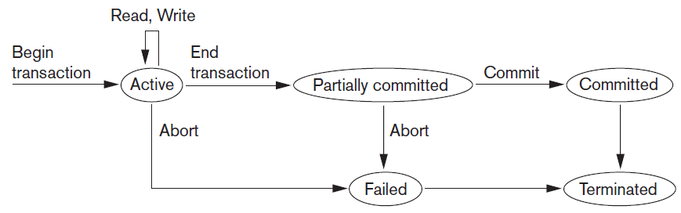
Transaction and System Concepts
Figure 20.4 State transition diagram illustrating the states for transaction execution

Slide 21
The System Log
System log keeps track of transaction operations
Sequential, append-only file
Not affected by failure (except disk or catastrophic failure)
Log buffer
Main memory buffer
When full, appended to end of log file on disk
Log file is backed up periodically
Undo and redo operations based on log possible

Slide 22
Commit Point of a Transaction
Occurs when all operations that access the database have completed successfully
And effect of operations recorded in the log
Transaction writes a commit record into the log
If system failure occurs, can search for transactions with recorded start_transaction but no commit record
Force-writing the log buffer to disk
Writing log buffer to disk before transaction reaches commit point

Slide 23
DBMS-Specific Buffer Replacement Policies
Page replacement policy
Selects particular buffers to be replaced when all are full
Domain separation (DS) method
Each domain handles one type of disk pages
Index pages
Data file pages
Log file pages
Number of available buffers for each domain is predetermined

Slide 24
DBMS-Specific Buffer Replacement Policies (cont’d.)
Hot set method
Useful in queries that scan a set of pages repeatedly
Does not replace the set in the buffers until processing is completed
The DBMIN method
Predetermines the pattern of page references for each algorithm for a particular type of database operation
Calculates locality set using query locality set model (QLSM)

Slide 25
20.3 Desirable Properties of Transactions
ACID properties
Atomicity
Transaction performed in its entirety or not at all
Consistency preservation
Takes database from one consistent state to another
Isolation
Not interfered with by other transactions
Durability or permanency
Changes must persist in the database
Notes:
Atomicity: A transaction is an atomic unit of processing; it is either performed in its entirety or not performed at all.
Isolation: A transaction should not make its updates visible to other transactions until it is committed; this property, when enforced strictly, solves the temporary update problem and makes cascading rollbacks of transactions unnecessary (see Chapter 21).
Durability or permanency: Once a transaction changes the database and the changes are committed, these changes must never be lost because of subsequent failure.

